Slide 1

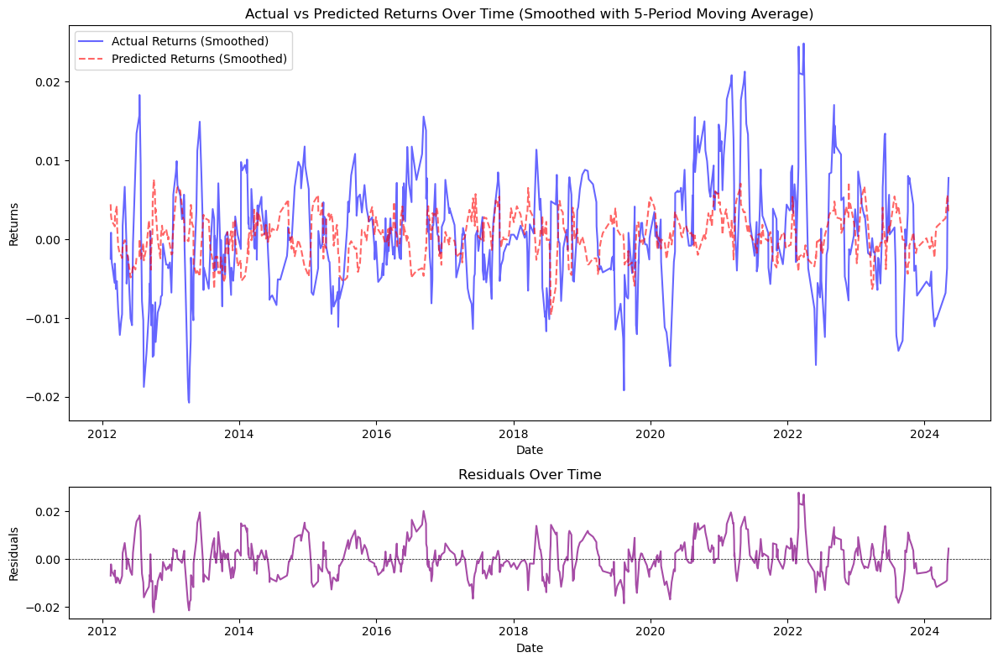
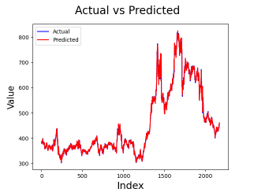
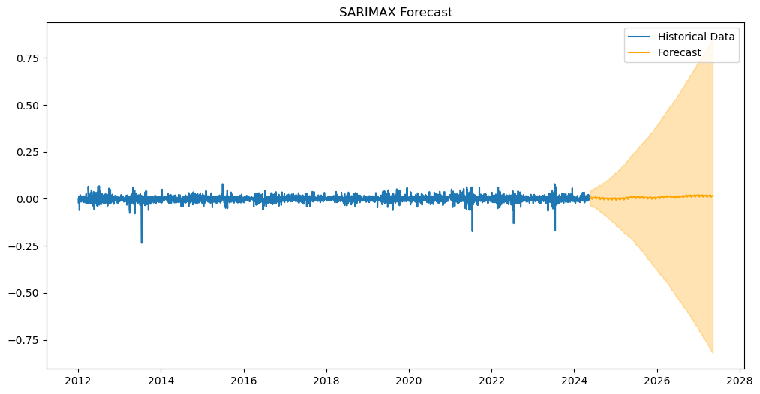
"Evaluating the Impact of Weather Conditions on Agricultural Stock Market Performance Using Time Series Forecasting""
Rosemary Dejesus Ramirez Cords
Higher Diploma in Science in Data Analytics for Business
INTRODUCTION
The Random Forest Regressor with PCA showed more promise, capturing more complex relationships between the features and returns. However, this model exhibited a higher mean error and an R² of around 0.57, indicating room for improvement. Residual analysis revealed issues during periods of high volatility, suggesting that the model may not be entirely reliable in turbulent market conditions.
Agriculture is highly sensitive to climate change, with extreme weather events, disrupting seasonal patterns and destabilizing production. These disruptions not only affect grain supply but also drive price volatility.
This extends this understanding by examining the broader economic consequences of weather events, particularly their influence on financial markets, through how it affect the performance of stock market, and analysing the relationship between them.
By integrating insights from agriculture and financial markets, this research aims to advance decision-making forescat and predictions, providing actionable intelligence to investors and risk managers.
OBJECTIVES
The 3 points below represent the core focus of the entire study:
Examine the Impact of Weather Events on Stock Market Performance, analysing how some specific weather conditions influence in stock market returns over time.
Analyse the causal relationships between time series data points and external factors to identify key drivers of changes in the data, such as weather factors.
Test and compare different machine algorithm models to assess their accuracy in forecasting or capturing the underlying structure of the data.
CONCLUSION
METHODOLOGY AND MATERIALS
Based on the results, further fine-tuning, feature engineering, and model adjustments are necessary to improve accuracy, particularly in high-volatility environments, and to better capture the influence of external factors like weather on market dynamics. it would be valuable to expand the scope by incorporating a broader range of weather variables, considering longer time horizons, and experimenting with different machine learning models. These steps could provide a deeper understanding of the complex relationship between weather and stock market trends. Additionally, segmenting the analysis by geographical regions and incorporating external economic variables may help improve model accuracy and produce more targeted insights.
The methodology involves collecting and preprocessing historical data on weather and stock market, ensuring clean and normalized datasets aligned over time. Exploratory Data Analysis (EDA) is conducted to uncover patterns and relationships between weather events and stock market performance. We then apply various modelling approaches: ARIMA and SARIMA to capture time-series trends and seasonality, while Linear Regression and Random Forest Regressor captures actual and predicted values. Models are evaluated using metrics like MAE, RMSE, and R-squared, with cross-validation and hyperparameter tuning enhancing performance. Finally, a forescat is performed to understand and predict the economic impacts of extreme weather.
RESULTS
The Linear Regression model yielded promising results, with a high R² close to 1, indicating that it captured most of the variability in the data. Its low mean error suggests that the predicted values were close to the actual returns, making it suitable for short-term predictions.
REFERENCES
Brownlee, J. (2017). Introduction to Time Series Forecasting With Python. Machine Learning Mastery.
Iqbal, M. (2024). ARIMA Times Series Model. Lecture 6 Week 1. CCT Moodle: CCT College.
McKinney, W. (2018). Python for Data Analysis Data Wrangling with Pandas, NumPy, and IPython. [online] file:///C:/Users/Dell/Downloads/Python%20for%20Data%20Analysis.%20Data%20Wrangling%20with%20Pandas,%20NumPy,%20and%20IPython%20(2017,%20O%E2%80%99Reilly)%20(3).pdf. Available at: http://oreilly.com/catalog/errata.csp?isbn=9781491957660.
McQuaid, D. (2024a). Feature Scaling or Normalization. file:///C:/Users/Dell/Downloads/Feature%20Scaling%20or%20Normalization%20(3).pdf.
McQuaid, D. (2024b). What is Exploratory Data Analysis? file:///C:/Users/Dell/Downloads/Feature%20Scaling%20or%20Normalization%20(3).pdf.
Müller, A.C. and Guido, S. (2016). Introduction to Machine Learning with Python A GUIDE FOR DATA SCIENTISTS. [online] https://www.nrigroupindia.com/e-book/Introduction%20to%20Machine%20Learning%20with%20Python%20(%20PDFDrive.com%20)-min.pdf. Available at: http://safaribooksonline.com/.
On the other hand, the SARIMA model indicated stability around zero with no strong trend, but the widening confidence intervals highlighted growing uncertainty over longer forecasting horizons. The negative R² suggested that the model performed poorly, likely due to issues with feature selection or the data preparation process, which affected its ability to predict accurately.

